Slide 1
Remote Procedure Call (RPC)

Slide 2
RPC: In a nutshell…
Goal: write distributed programs in the same way non-distributed programs have been written
calling a procedure on a remote machine as if it were a local procedure call.
Unique requirements:
Multiple program units (e.g. chunks of programs running on different machines concurrently.
Communication among program units.

Slide 3
Conventional Procedure Calls
P3
.
P1()
.
P2
.
P3()
.
P1
.
P2()
.
Program Unit

Slide 4
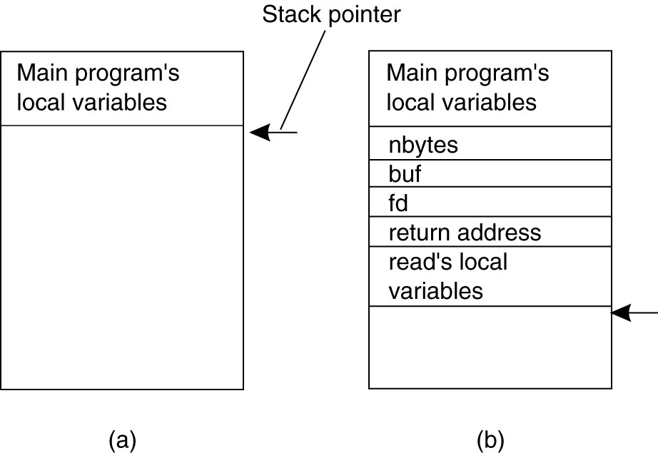
Conventional Procedure Call: Detail
(a) Parameter passing in a local procedure call: the stack before the call to read.
(b) The stack while the called procedure is active.
Notes:
We now look at RPC, but before we do so we need to understand how a conventional procedure call works.
Example function call in C:
count = read(fd, buf, nbytes);
Note, that buf is call-by-reference, since it is an array, fd and nbytes are call-by-value.

Slide 5

Remote Procedure Calls
Program Unit #1
Program Unit #2
P2
.
P3()
.
P3
Network
.
P1()
.
P1
.
P2()
.

Slide 6
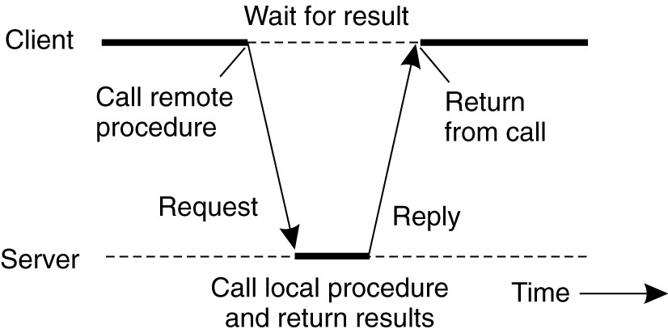
Client and Server
Communication between caller & callee can be hidden by using procedure-call mechanism.
Notes:
Goal is to make a remote procedure call transparent to the programmer.
Instead of calling the actual procedure, the client calls a client stub which essentially creates a message and sends the request across the network.
When the server machine receives the message it passes it up to a server stub, which does the opposite of the client stub, i.e.. Unpacks the message and calls the local procedure.
When the local procedure on the remote server returns, the server stub creates a message containing the return value and sends it to the client. When the client machines receives the message it unpacks it and returns the return value to the calling code.

Slide 7
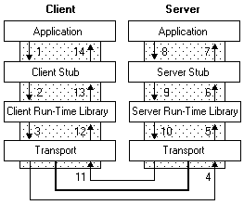
How RPC Works
Source: https://docs.microsoft.com/en-us/windows/desktop/Rpc/how-rpc-works

Slide 8
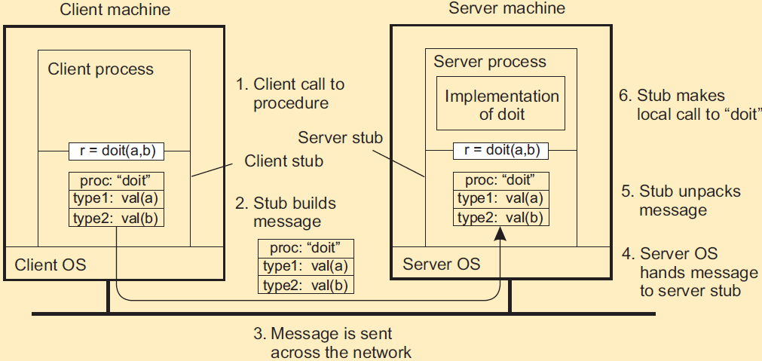
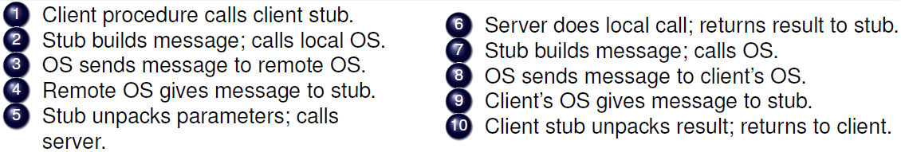
Detail
Notes:
Parameter Marshalling. – packing parameters into a message – not as easy as it sounds!.

Slide 9
RPC: Parameter passing
There’s more than just wrapping parameters into a message
Client and server machines may have different data representations (think of byte ordering)
Wrapping a parameter means transforming a value into a sequence of bytes
Client and server have to agree on the same encoding
How are basic data values represented (integers, floats, characters)
How are complex data values represented (arrays, unions)
Client and server need to properly interpret messages, transforming them into machine-dependent representations.

Slide 10
Discussion
Please give an example of synchronous communication and asynchronous communication related to computing system respectively, and briefly explain why it is synchronous or asynchronous.
Please go to
PollEv.com/cisgvsu429

Slide 11
Discussion
Please give an example of synchronous communication and asynchronous communication related to computing system respectively, and briefly explain why it is synchronous or asynchronous.
Synchronous: real-time; sender waiting for receiver’s reply during the communication
Video conferencing
Youtube
Asynchronous: no need for real-time
Email
Posting in Facebook

Slide 12
Discussion
Please give an example of synchronous communication and asynchronous communication in your daily life (non IT or computing field) respectively, and briefly explain why it is synchronous or asynchronous.
Please go to
PollEv.com/cisgvsu429

Slide 13
Discussion
Please give an example of synchronous communication and asynchronous communication in your daily life (non IT or computing field) respectively, and briefly explain why it is synchronous or asynchronous.
Synchronous: real-time
Phone call
Face-to-face communication
Asynchronous: no need for real-time
Texting
Mailing

Slide 14
Asynchronous vs. Synchronous Communication
Asynchronous communication
does not wait around for a reply
Synchronous communication
requires parties or components to work simultaneously in real time
Quick Discussion:
Based on what we learned about RPC so far, is it asynchronous or synchronous communication? Why?
Notes:
Synchronous communication

Slide 15
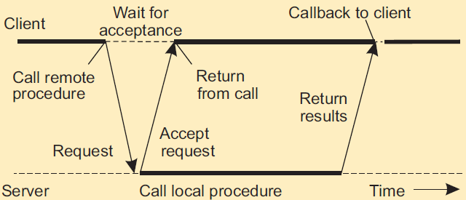
Asynchronous RPCs
Try to get rid of the strict request-reply behavior, but let the client continue without waiting for an answer from the server.
Call Back

Slide 16
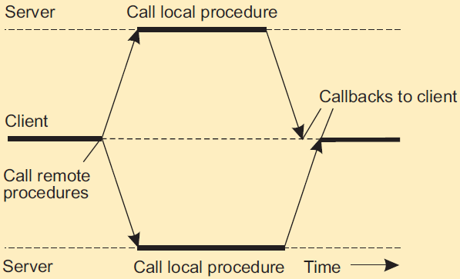
Sending out multiple RPCs
Sending an RPC request to a group of servers

Slide 17
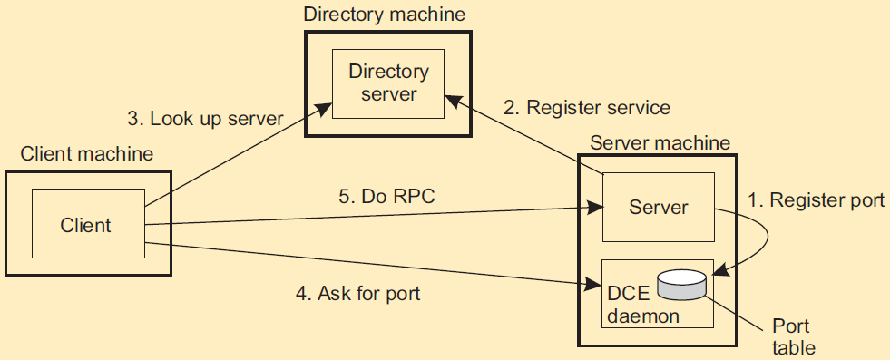
Client-to-server binding
Client must locate server machine
Distributed Computing Environment (DCE)

Slide 18
Summary
Client/Server computing is generally based on a model of synchronous communication (except call back for asynchronous RPC)
Client and server have to be active at time of communication
Client issues request and blocks until it receives reply
Server essentially waits only for incoming requests, and subsequently processes them
Drawbacks: synchronous communication
Client cannot do any other work while waiting for reply
Failures have to be handled immediately: the client is waiting
The model may simply not be appropriate (mail, news)

Slide 19
Discussion
Could you give examples in your daily life that are analogous/similar to the idea of local procedure call and RPC?
Please go to
PollEv.com/cisgvsu429

Slide 20
Discussion
Could you give examples in your daily life that are analogous/similar to the idea of local procedure call and RPC?
My example:
Local procedure call: press the “start” button of a dish washer at home
RPC: If your dish washer is intelligently connected to Internet, then you operate the APP on your phone to remotely start the dish washer.

